Slide 1
Shravan exam
analysis

Slide 2
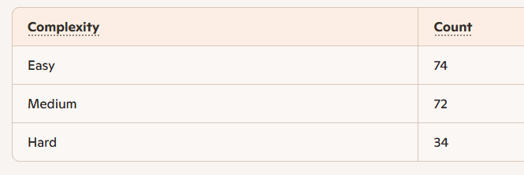
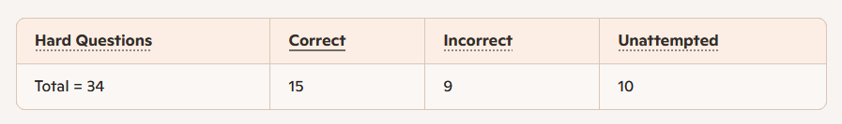
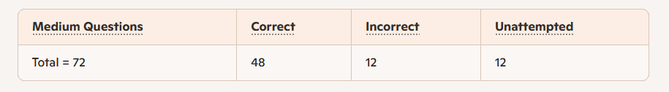
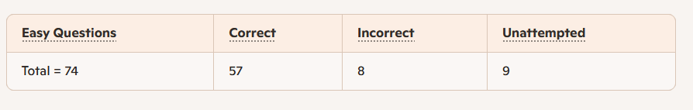

Slide 3
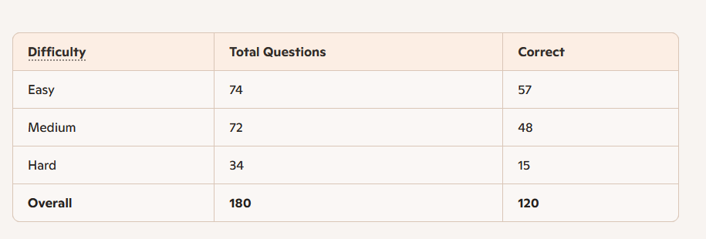
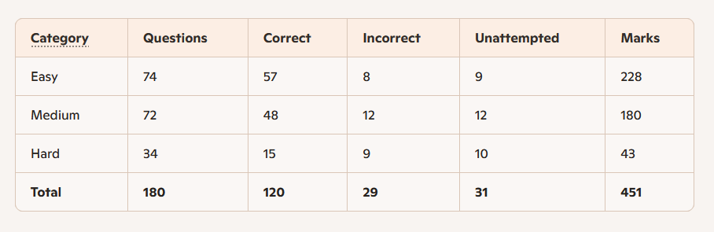

Slide 4
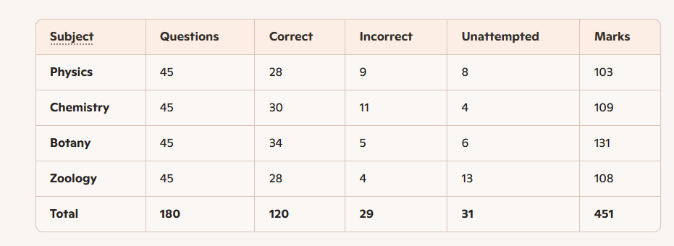

Slide 5
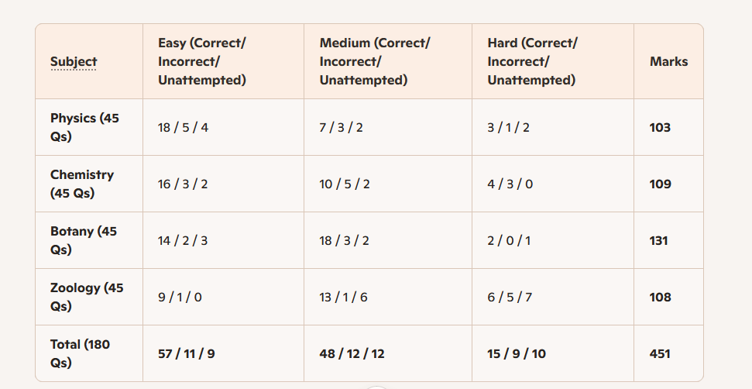

Slide 6
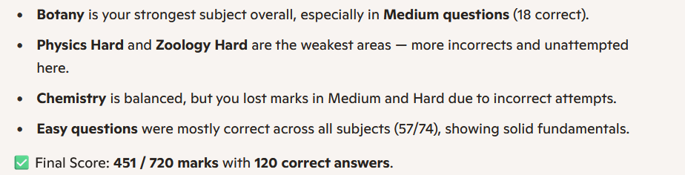

Slide 7
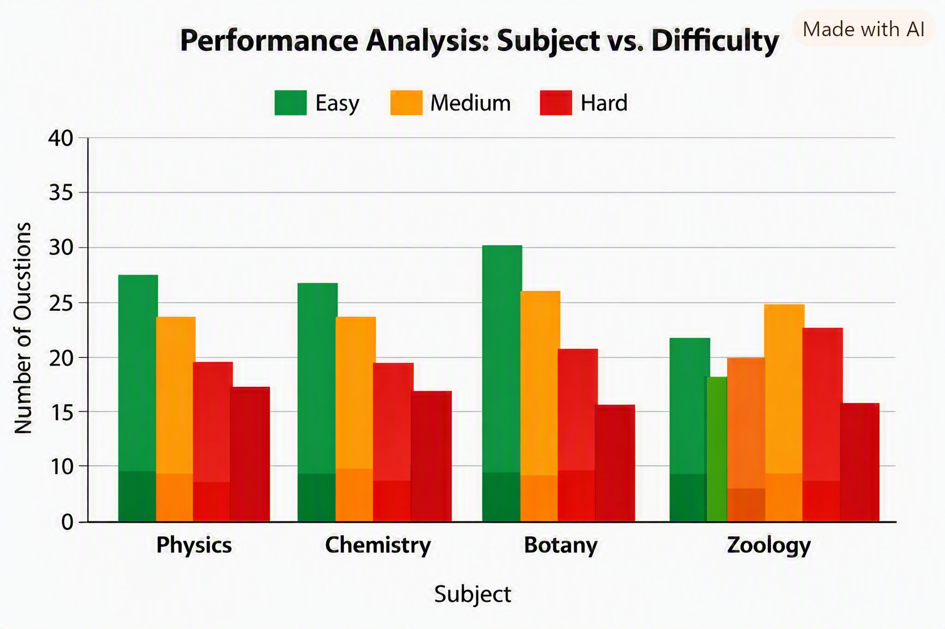

Slide 8
Focus Area | Action Plan
1. Physics Hard Mastery | Dedicate 1 hour daily to conceptual derivations and numerical problem sets from topics like kinematics, vectors, and projectile motion. Use Allen’s DLP or NCERT examples to strengthen reasoning speed.
2. Chemistry Medium Accuracy | Revise Physical Chemistry formulas and Organic reaction mechanisms weekly. Practice 30 mixed‑level MCQs per day to reduce careless errors.
3. Botany Retention Boost | You’re already strong — now focus on diagram‑based recall (plant anatomy, photosynthesis cycles). Use flashcards for quick visual memory reinforcement.
4. Zoology Concept Integration | Strengthen Human Physiology and Genetics with NCERT line‑by‑line reading. Attempt 20 mixed questions daily to convert unattempted ones into confident attempts.
5. Error Log System | Maintain a mistake notebook — categorize every wrong answer by reason (concept gap, calculation error, misread question). Review it every Sunday.
6. Timed Practice Blocks | Simulate exam conditions twice a week: 180 questions in 3 hours. Track accuracy vs. time per subject. Aim for >90% accuracy in Easy, >80% in Medium, >60% in Hard.
7. Formula & Concept Sheets | Create concise Physics equations, Chemistry constants, and Biology cycles sheets. Review them before sleep — spaced repetition improves recall.
8. Mock Analysis Routine | After each mock test, compute marks lost to negatives. Your current loss is 29 marks — target <15 by improving question selection discipline.
9. Mental Conditioning | Practice focus drills (Pomodoro 25‑min sessions) and breathing resets during long study hours. Mental clarity boosts precision under pressure.
10. Weekly Review & Adjustment | Every Sunday, compare your progress chart to this plan. Adjust subject focus dynamically — e.g., if Physics improves, shift extra time to Chemistry Hard.

Slide 9
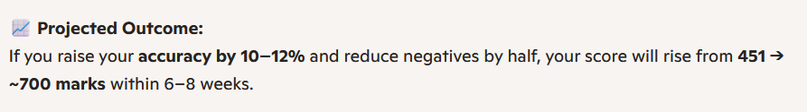
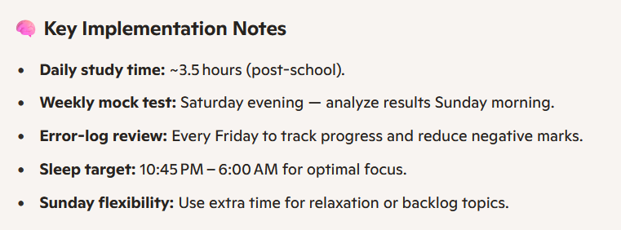

Slide 10
Day | 6:00 PM – 7:30 PM | 7:30 PM – 9:00 PM | 9:00 PM – 9:30 PM | 9:30 PM – 10:30 PM | Focus Summary
Monday | Physics Hard (Numericals + Derivations) | Chemistry Medium (Physical formulas) | Dinner + short walk | Biology (Botany diagrams) | Conceptual start to week
Tuesday | Zoology Medium (Human Physiology) | Physics Easy/Medium (Concept recall) | Dinner + relaxation | Chemistry Organic reactions | Reinforce fundamentals
Wednesday | Botany Medium (NCERT line‑by‑line) | Physics Hard (Kinematics + Vectors) | Dinner + breathing reset | Mock mini‑test (30 Qs) | Mid‑week performance check
Thursday | Chemistry Hard (Reaction mechanisms) | Zoology Easy (Quick MCQs) | Dinner + short walk | Physics formula sheet review | Strengthen weak Chemistry
Friday | Full‑subject mixed MCQs (Physics + Chemistry + Biology) | Error‑log analysis (review wrong answers) | Dinner + relax | Revision of top 20 missed concepts | Consolidation day
Saturday | Mock Test (180 Qs / 3 hrs 6:00–9:00 PM)** | — | — | — | Simulate exam conditions
Sunday | Morning (8:00–10:00 AM): Biology full revision | Afternoon (3:00–5:00 PM): Physics Hard practice | Evening (7:00–9:00 PM): Chemistry Medium review | — | Weekly review + adjustment

Slide 11
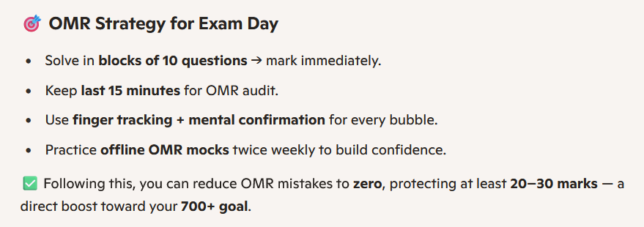
OMR mistakes can easily cost 20–30 marks, so eliminating them is critical for your 700‑mark target. Here’s a structured strategy to ensure zero OMR errors:
Guidelines to Avoid OMR Mistakes

Slide 12
Step | Action
1. Fixed Marking Rhythm | Always mark OMR after every 10 questions instead of at the end. This prevents last‑minute rush and reduces skipped bubbles.
2. Double‑Check Question Number | Before shading, glance at the question number on paper and OMR row. Train yourself to say it mentally: “Q45 → Row 45.”
3. Use Pencil Practice, Pen in Exam | Practice with pencil at home to simulate shading speed, but in exam use black ball‑point pen (mandatory).
4. Avoid Over‑shading | Fill bubbles cleanly — avoid pressing too hard or overlapping. Smudges can confuse scanners.
5. Cross‑verify Every Page | After finishing each OMR page, quickly scan rows to ensure no blanks or double marks.
6. Keep 15 Minutes Buffer | Reserve last 15 minutes of exam solely for OMR verification — not solving new questions.
7. Error‑log Simulation | In mocks, note every OMR mistake (wrong row, skipped bubble). Review weekly to see if errors reduce.
8. Use Finger Tracking | Place one finger on the question paper number and the other on the OMR sheet row while shading. This physical anchor reduces misalignment.
9. Don’t Delay Marking | Never postpone OMR filling till the end — fatigue + time pressure = maximum errors.
10. Practice with Real OMR Sheets | At least 2 mocks per week should be done on actual OMR sheets, not online. Build muscle memory for shading speed and accuracy.

